Slide 1

PEER
MENTORSHIP
Session 1

Slide 2

WHAT IS PEER MENTORSHIP PROGRAM?
It is a peer support program that assists new students to make a smooth transition into university life.

Slide 3
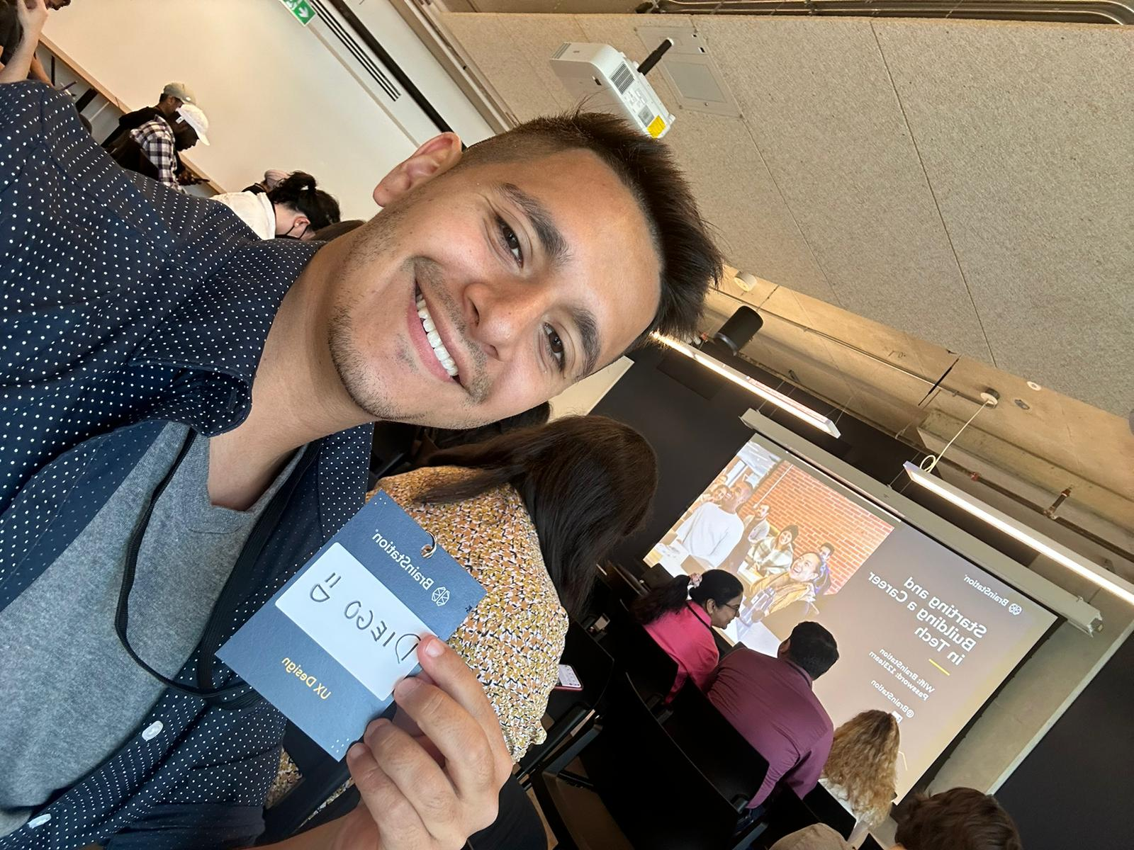
WHO AM I?
Second year Software Engineering Student
Electronics Engineering Technologist
Sports Fan
Tutor

Slide 4

WE ARE MENTORS
AND NOT TAS

Slide 5


EXPECTATIONS
Coming to these sessions Attendance will be taken Fill the feedback forms
Ask us questions so we can help you transition better

Slide 6

HOW TO CONTACT YOUR MENTOR?
Use eclass discussion under Peer Mentorship tab or send an email!

Slide 7
IMPORTANT DATES
Last day to add a course without instructor’s permission: September 18
Drop deadline: November 8 Reading Week: October 12-18
You can check sessional dates, add/drop deadlines, or financial deadlines on the provided website. Information is take from: https://registrar.yorku.ca/enrol/dates/2024-2025/fall-winter

Slide 8
NAVIGATING ECLASS

Slide 9
BEST WAY TO CONTACT A PROFESSOR
Some courses have forums set up
Some professors make a class Discord Email
Office hours
Talk after lecture (some do tend to answer questions)

Slide 10

YOU CAN FILL YOUR
FAAS APPLICATION!
FINANCIAL AID, AWARDS, AND SCHOLARSHIP APPLICATION
https://students.yorku.ca/sfs/awards-and-scholarships

Slide 11

ACTIVTIY

Slide 12
TWO TRUTHS AND A LIE
I am married
I have 2 tattoos
I work part-time as a bartender

Slide 13

ASK QUESTIONS!

Slide 14

Keele Feedback

